Slide 1

TELECOM CHURN ANALYSIS
BY GROUP 6

Slide 2
PROBLEM STATEMENT:
Telecommunication companies often face problem with customer churn, which is the loss of customers who stop using their services. To solve this problem, companies need to identify the customers who are likely to unsubscribe their services and take pre-emptive measures to retain them. With the help of various Machine learning models, we can predict the customers who are most likely to churn, based on various factors such as customer usage patterns, payment history, and demographics.
PRIMARY PURPOSE:
The fundamental goal of these predictive models is to anticipate whether a telecommunications customer will cancel their subscription or not. These models provide a probability or binary classification label for each customer, indicating the probability of churn. This forecast can be quite useful for recognizing customers who may be considering leaving and implementing proactive strategies to keep them engaged.

Slide 3
converting all categorical variables into dummy variables.
Data Cleaning:
The dataset used in this project contains 21 columns and 7,043 rows. The first step in the data cleaning process was to remove any missing values in the dataset.
Converting churn predictor variable to binary numeric value.

Slide 4
Now we perform the DATA VISUALIZATION on the data to get the insights about the customer churn based on following factors.
Note that we have the following parameters in the Dataset and we tried to introduce the relevant variables into our consideration.
customerID, gender, SeniorCitizen, Partner,
Dependents, tenure, PhoneService MultipleLines
InternetService OnlineSecurity OnlineBackup DeviceProtection
TechSupport StreamingTV StreamingMovies Contract
PaperlessBilling PaymentMethod MonthlyCharges TotalCharges
Churn
Only monthlycharges, tenure, churn are numerical variable. Rest are categorical.

Slide 5
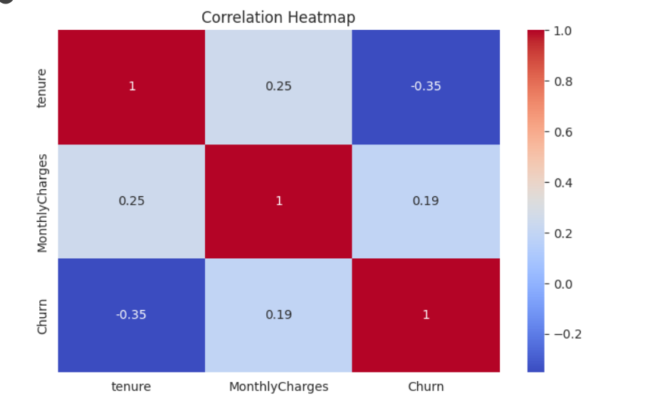
Correlation Heatmap:
We have used the correlation heatmap on the variables like tenure, monthly charges and churn as we cannot use categorical variables in heatmap, we used the numerical variables.

Slide 6
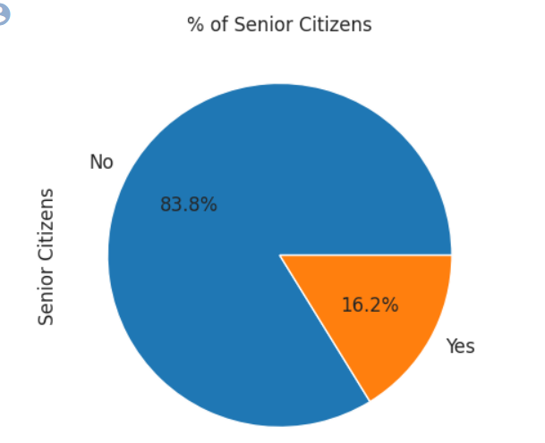
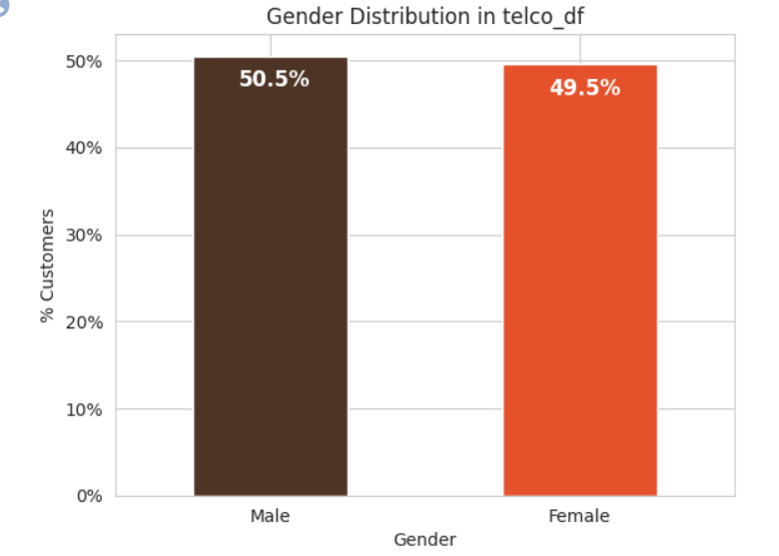
Gender Distribution - About half of the customers in our data set are male while the other half are female.
Senior Citizens - There are only 16% of the customers who are senior citizens.
Thus, most of our customers in the data are younger people.

Slide 7
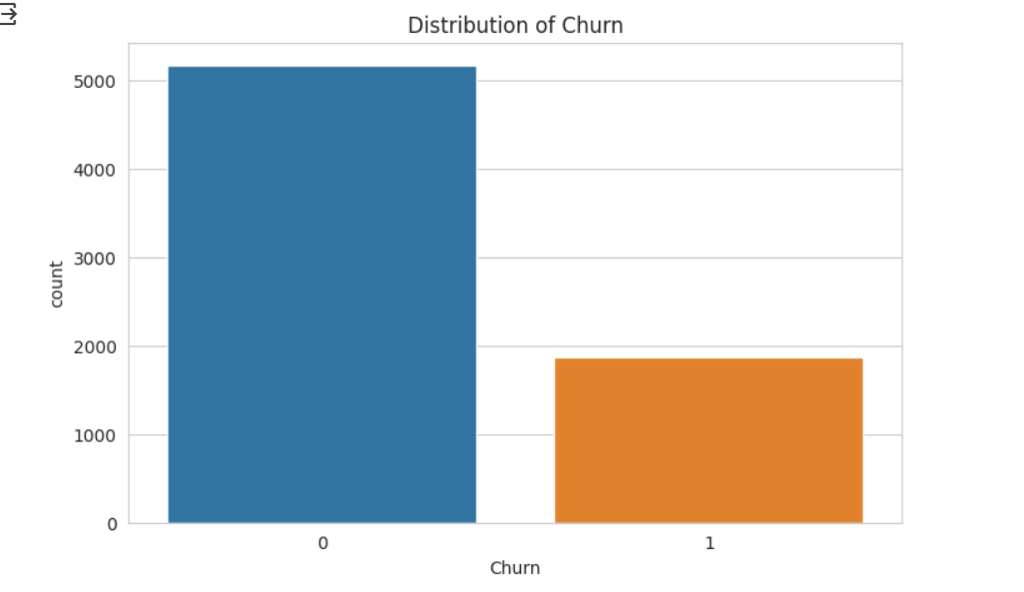
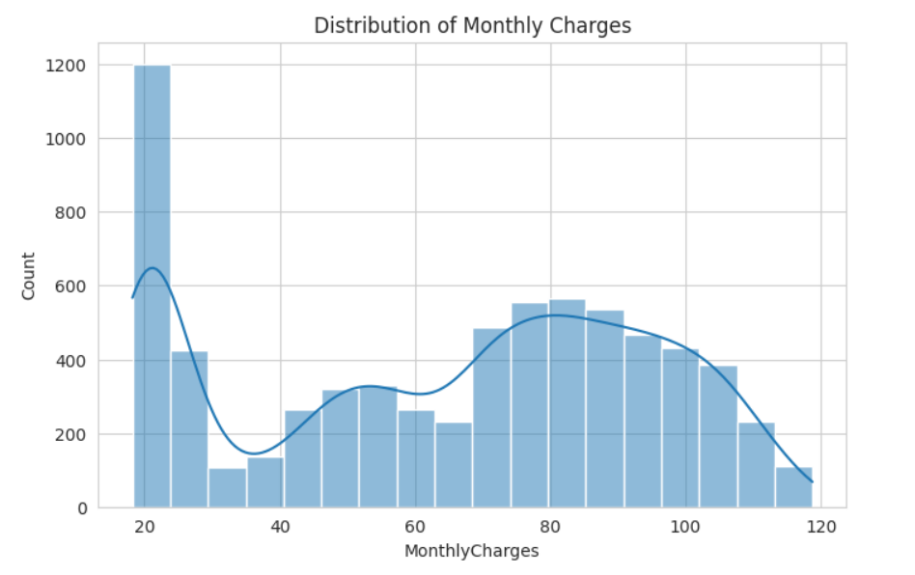
Distribution of monthly charges:
We can see that a greater number of customers were using the basic monthly charges of 20.
Distribution of churn:
This graph gives the overall churn distribution in the data.
Notes:
Now, we will talk about some observation and patters on the dataset. We can see that more than 5000 subscribers did not churn, whereas nearly 2000 subscriber were churned. And also, from the monthly distribution we can see that the highest number of users are using 20usd charge/permonth.

Slide 8
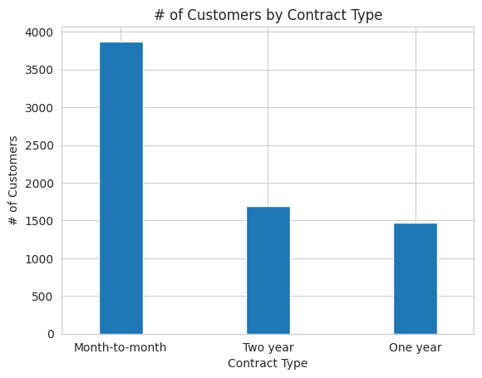
As we can see from this graph most of the customers are in the month to
month contract. While there are equal number of customers in the 1 year and
2 year contracts.

Slide 9
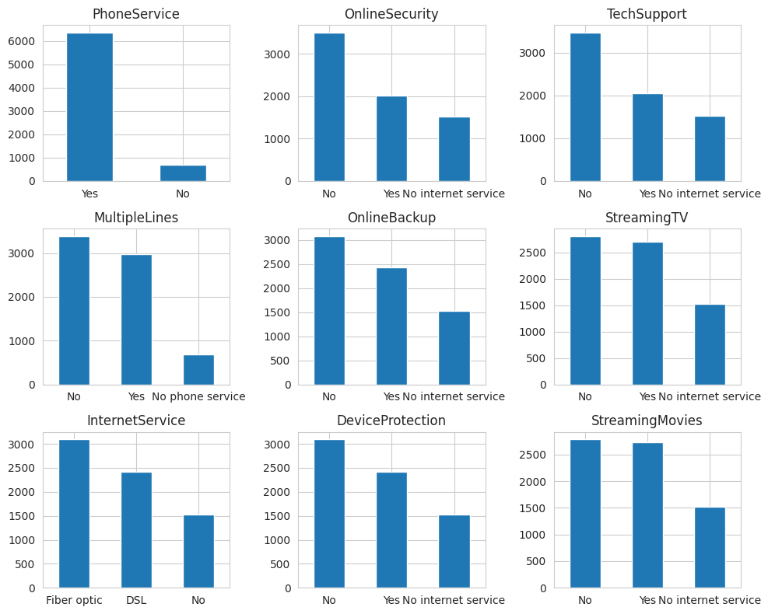
Distribution of various services used by customers

Slide 10
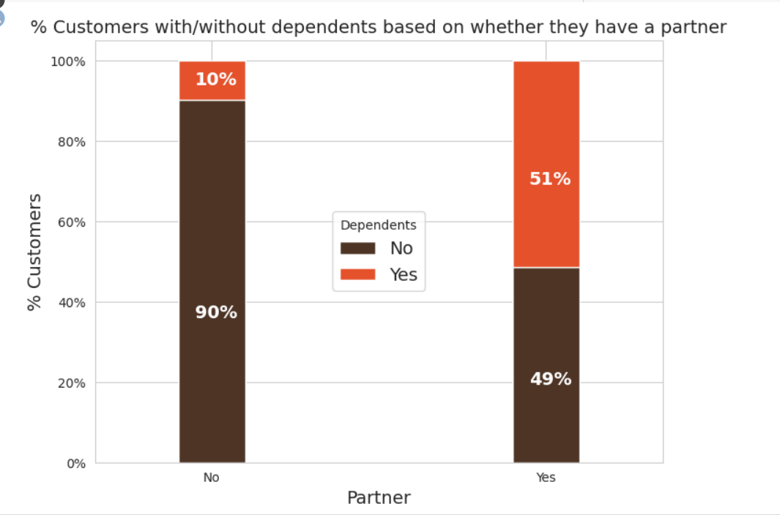
Interestingly, among the customers who have a partner, only about half of them also have a dependent, while other half do not have any independents. Additionally, as expected, among the customers who do not have any partner, a majority (80%) of them do not have any dependents.

Slide 11
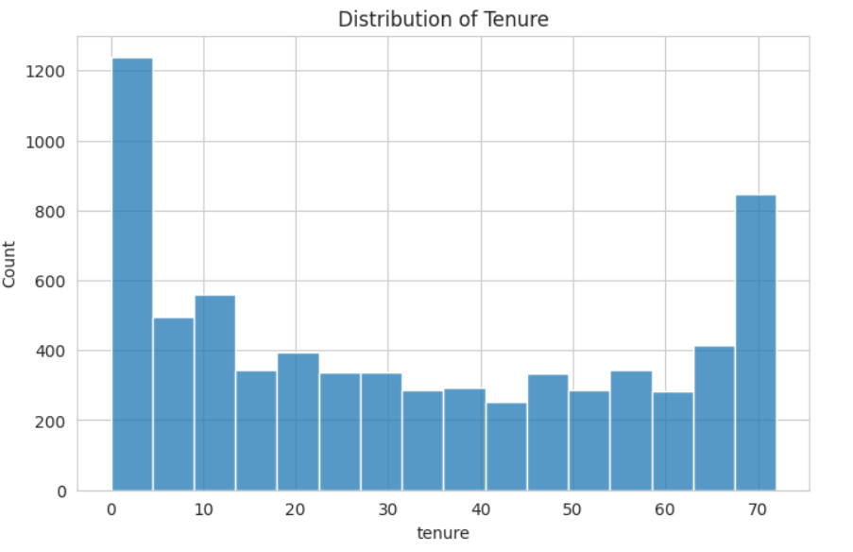
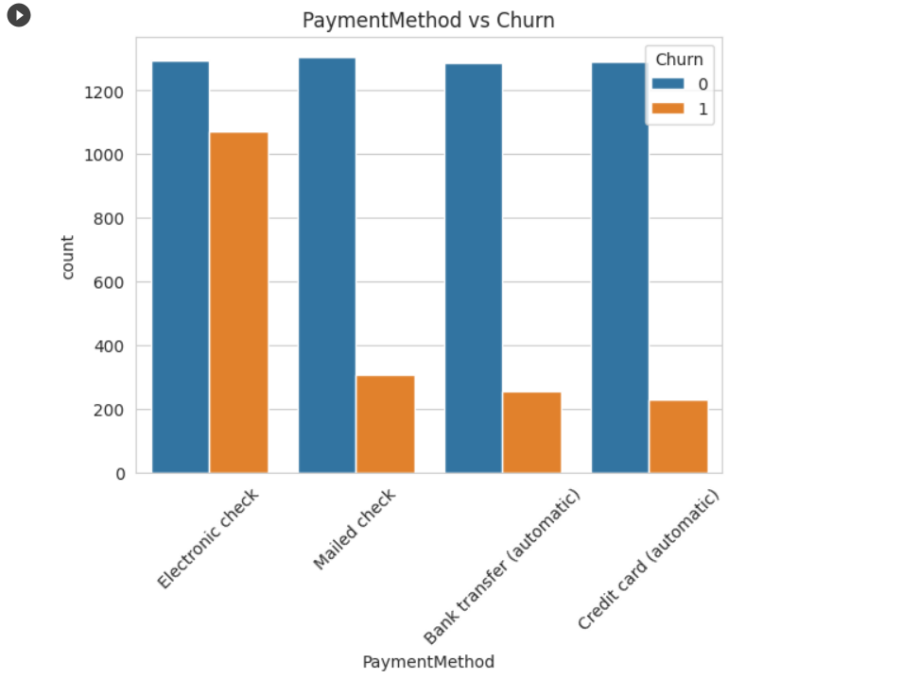
Payment method vs churn:
The churn rate is more in the electronic check payment method.
Distribution of tenure:
We can understand that more customers were not long term but have shorter tenure.

Slide 12
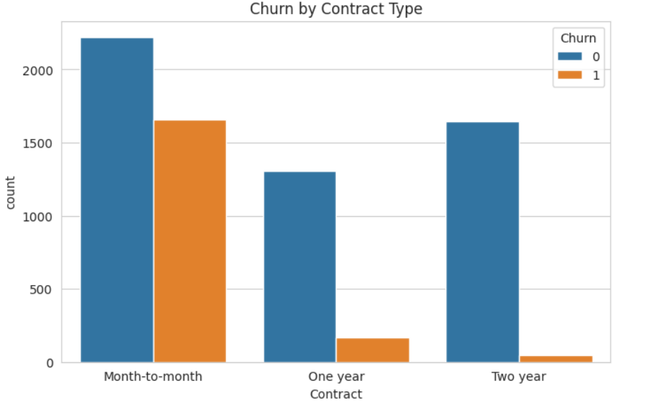
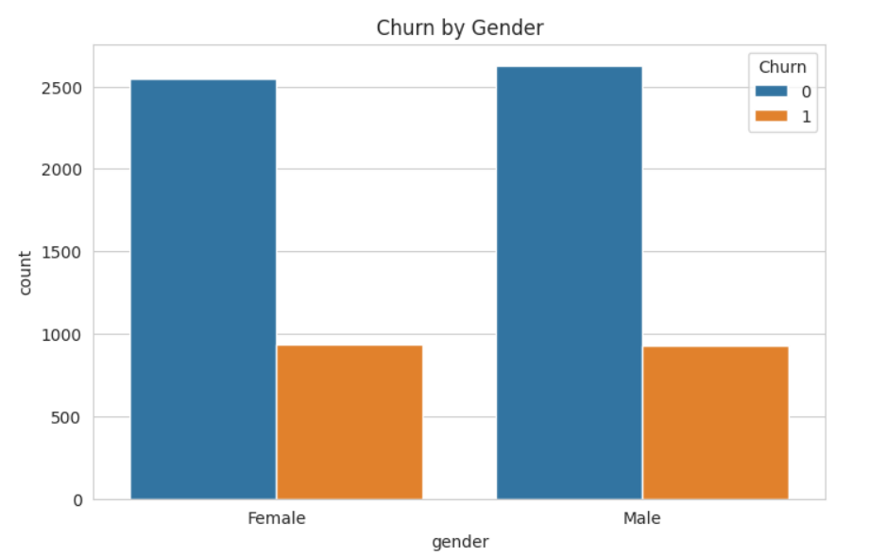
Churn by gender:
Churn rate is almost similar in both the genders from the following graph.
Churn by contract type:
We can see that month-to-month contract type have higher churn value than other two criteria.

Slide 13
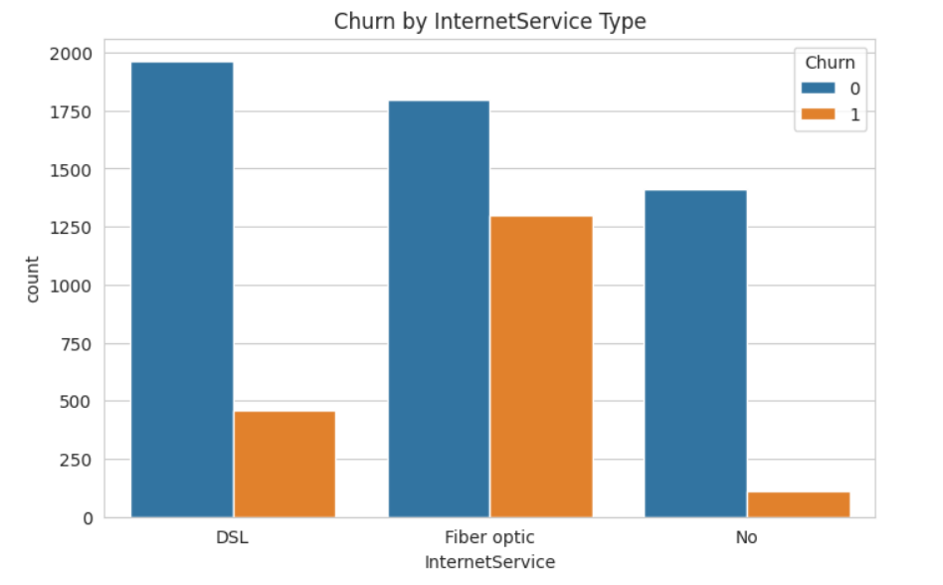
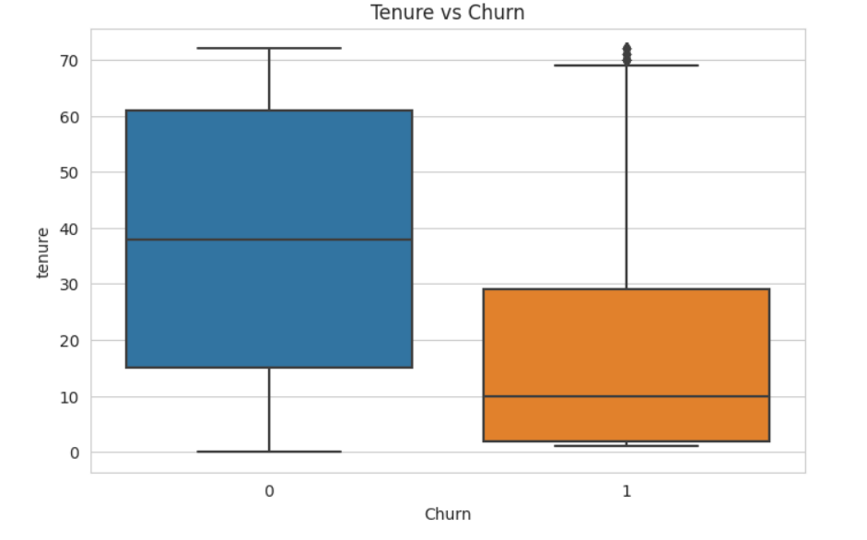
Tenure vs churn:
Customers who have been with the company for a longer tenure are less likely to churn compared to customers with shorter tenure.
Churn by Internet Service type:
We can deduce the Fiber optic internet service has high churn rate.

Slide 14
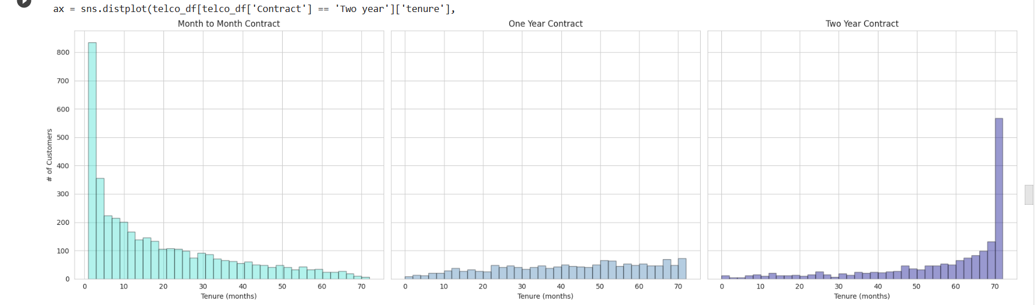
Interestingly most of the monthly contracts last for 1-2 months, while the 2-year contracts tend to last for about 70 months. This shows that the customers taking a longer contract are more loyal to the company and tend to stay with it for a longer period of time.

Slide 15
After the data visualization we defines two functions for visualizing the performance of classification models:
-“plot_confusion_matrix” Function:
It calculates the confusion matrix between the true and predicted labels using the confusion_matrix function from scikit-learn.
The function then creates a heatmap visualization of the confusion matrix using Seaborn's heatmap function. The heatmap provides a visual representation of the number of true positives, true negatives, false positives, and false negatives.
-“plot_roc_curve” Function:
It calculates the Receiver Operating Characteristic (ROC) curve and the Area Under the Curve (AUC) score.
The ROC curve is a plot of the True Positive Rate (TPR) against the False Positive Rate (FPR) at various threshold values. It shows the trade-off between sensitivity and specificity of a classification model.
The function plots the ROC curve using Matplotlib, with the AUC value included in the legend.

Slide 16
Models:
When tackling a classification problem, there is no one-size-fits-all algorithm. We explore various models and ultimately select the most suitable one based on accuracy and F1 score, aiming for the highest achievable performance.
In our evaluation process, we considered the following models:
Logistic Regression
Decision Tree Classifier
Random Forest Classifier
K-Nearest Neighbors (KNN)
Naive Bayes Classifier
After careful assessment, we determined the best-performing model to address our specific problem and maximize both accuracy and the F1 score.

Slide 17
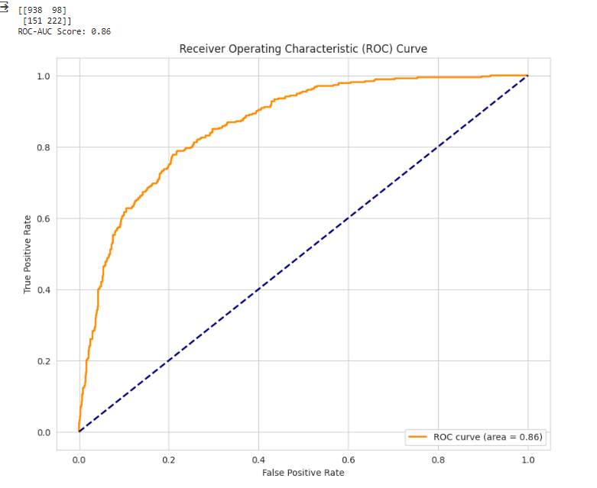
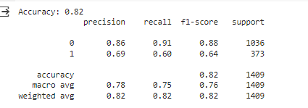
Based on the accuracy:
We can deduce that Logistic Regression has the highest accuracy out of all with 0.82 and with an ROC curve area of 0.84.

Slide 18
Conclusion:
In conclusion, this project aimed to predict customer churn in the telecom industry using a machine learning model. The dataset was cleaned by removing duplicates and imputing missing values. Exploratory Data Analysis was performed to analyze the distribution of the independent variables and the target variable. Five models were used to predict customer churn, and the Logistic Regression model had the highest accuracy, F1-score and ROC curve area.

